Slide 1
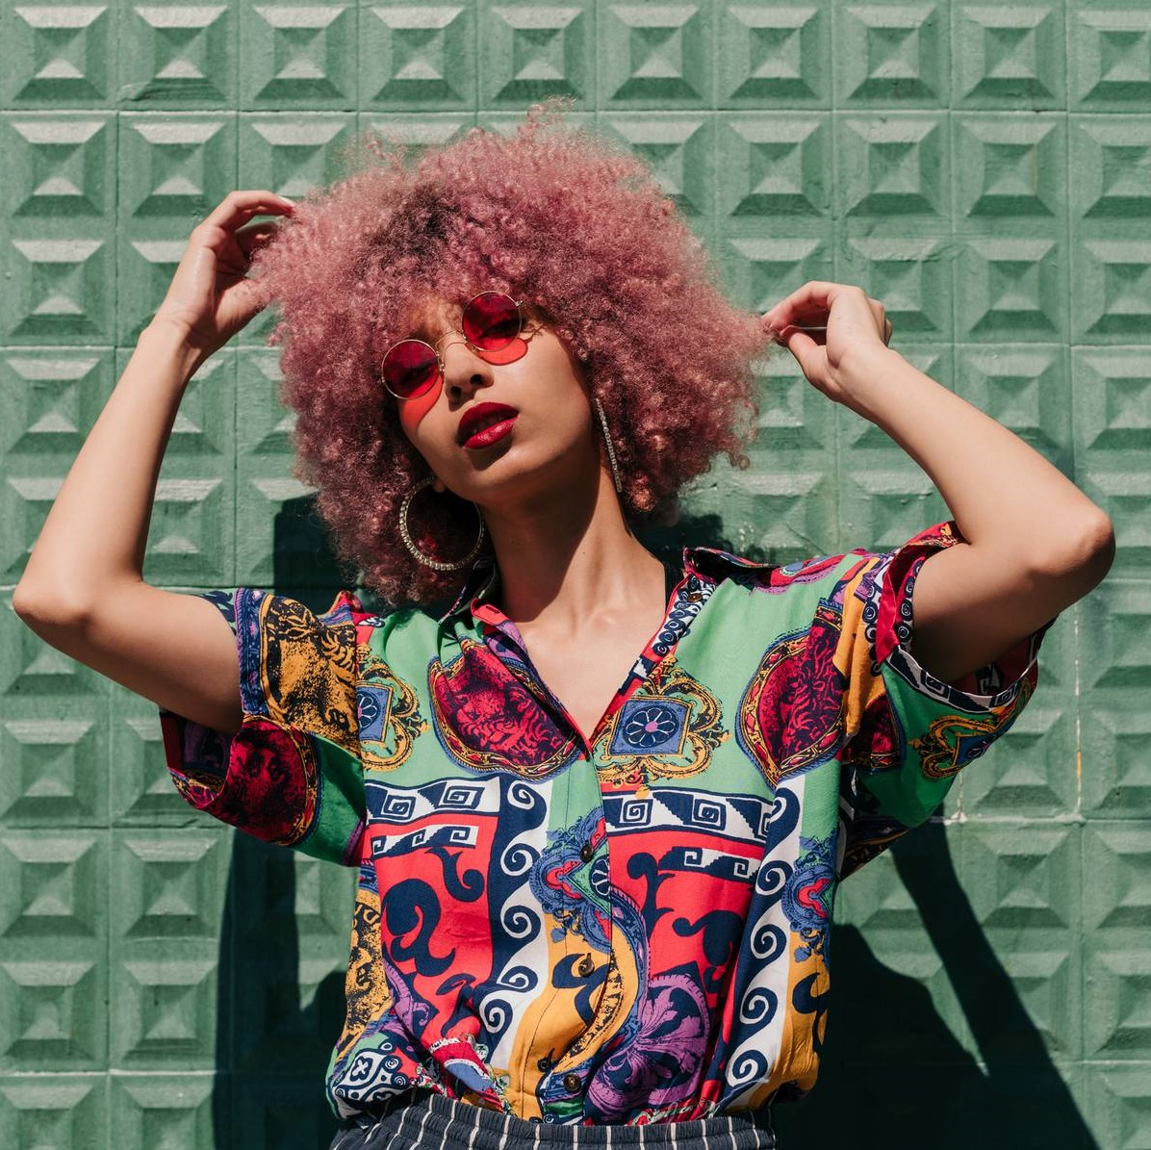
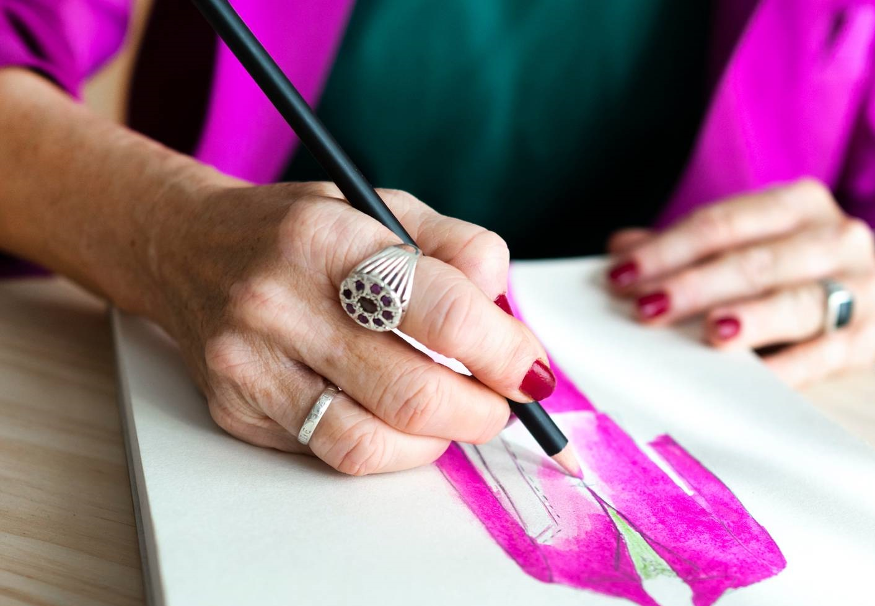

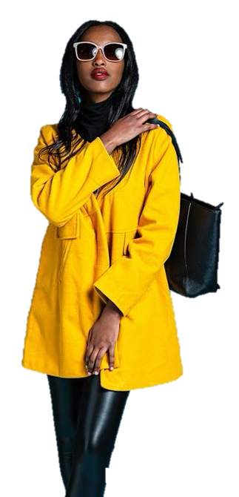
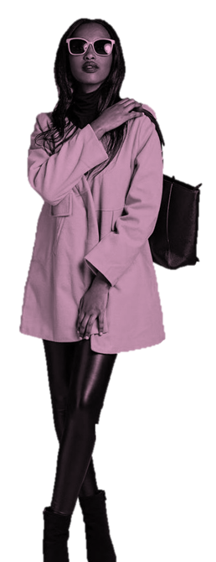
Fashion
NYKAA
By Suresh
All the newest trends, styles, and inspiration for your hottest Spring looks

Slide 2

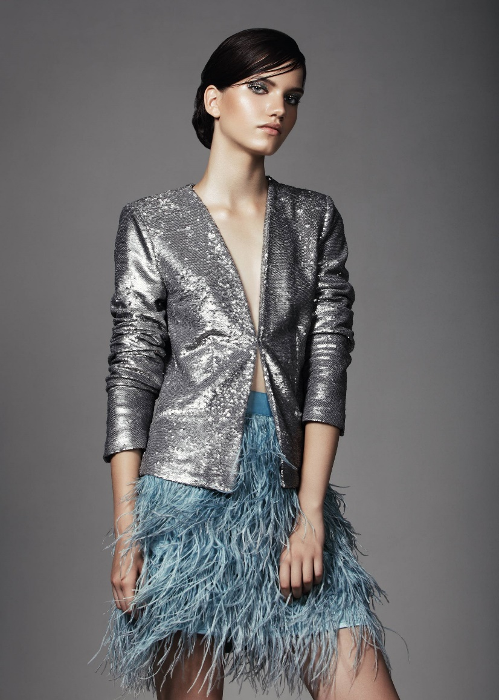
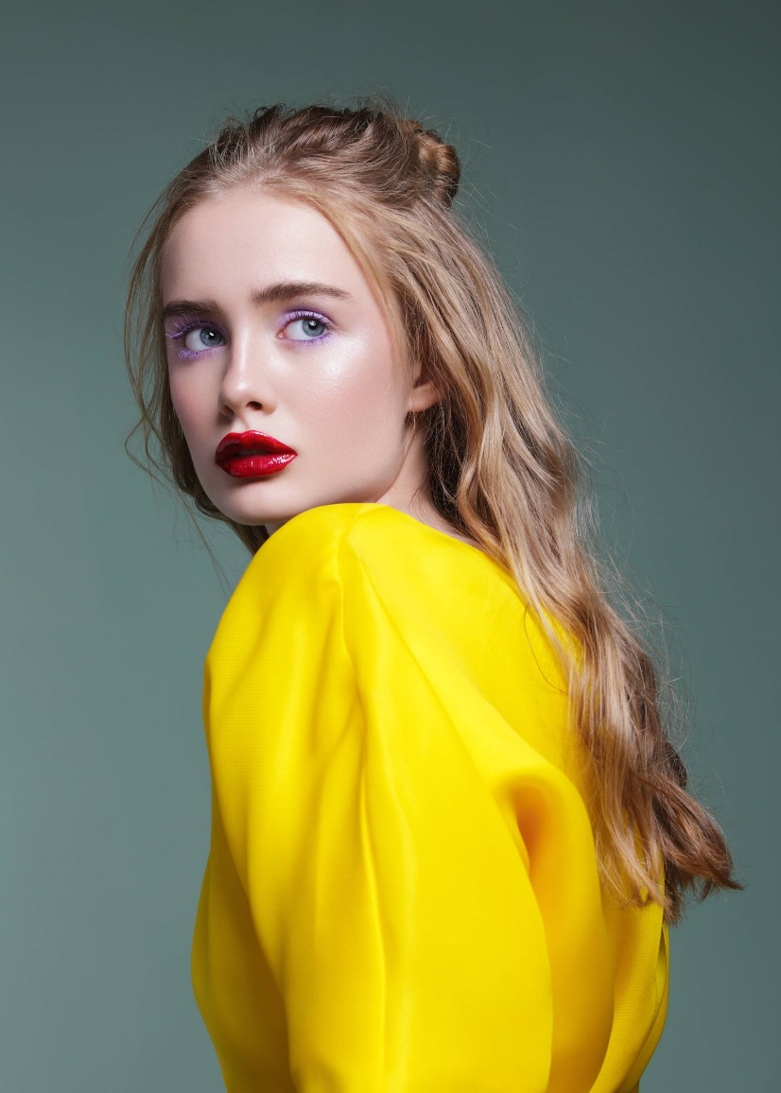

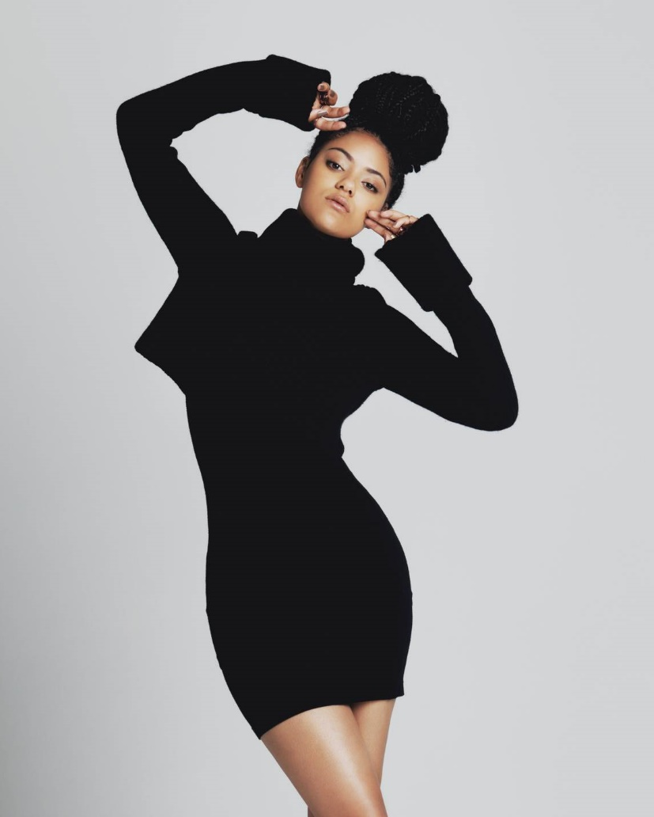
Looks
Fresh
No more rules – the most popular trend is a unique sense of personal style
Overview of Nykaa
Nykaa’s parent company is officially known as FSN E-Commerce Ventures Ltd, is an Indian retail company headquartered in Mumbai. Founded in 2012 by Falguni Nayar, it began as a digital- first platform focused on beauty and wellness products. Over time, Nykaa transitioned to an omnichannel model, expanding its reach through a combination of its website, mobile apps, and physical retail stores.

Slide 3
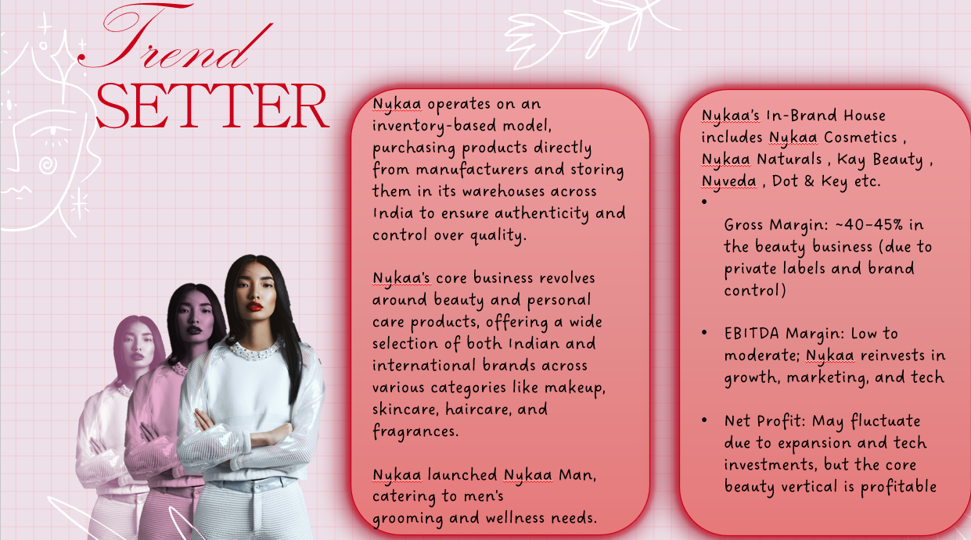



Setter
Trend
Business model
Nykaa operates on an inventory-based model, purchasing products directly from manufacturers and storing them in its warehouses across India to ensure authenticity and control over quality.
Nykaa's core business revolves around beauty and personal care products, offering a wide selection of both Indian and international brands across various categories like makeup, skincare, haircare, and fragrances.
Nykaa launched Nykaa Man, catering to men's grooming and wellness needs.
Nykaa’s In-Brand House includes Nykaa Cosmetics , Nykaa Naturals , Kay Beauty , Nyveda , Dot & Key etc.
Gross Margin: ~40–45% in the beauty business (due to private labels and brand control)
EBITDA Margin: Low to moderate; Nykaa reinvests in growth, marketing, and tech
Net Profit: May fluctuate due to expansion and tech investments, but the core beauty vertical is profitable

Slide 4
MARKET REACH AND GROWTH
Market Reach and Growth
STRATEGIES AND EVENTS:
Nykaa uses the digital marketing strategy with content marketing, influencer tie-ups, SEO, and email campaigns. It also boosts brand presence through events like the Nykaa Femina Beauty Awards and Nykaaland.
TARGETING:
Nykaa primarily targets women aged 18 to 45, catering to diverse income levels (middle to upper-middle class) and geographical locations, including metro, tier 1, tier 2, and tier 3 cities in India.
Financial Performance:
Nykaa has shown impressive financial performance, with consistent revenue growth and profitability in recent years. In FY25, Nykaa reported a total revenue of ₹7,977.08 crore. CAGR for online channel is 25% and for offline stores is 14%.
1 2 3

Slide 5
Competitive analysis
Competitors:
Amazon, Flipkart, Purplle, Myntra, Tira, Tata CLiQ Palette, SS Beauty etc. are some of the competitors for Nykaa.
Competitive Advantage:
Inventory-Based Model (Beauty): Pricing and storage of products to meet the customer orders on time.
Strong In-House Brands: Nykaa Cosmetics, Nykaa Naturals, Kay Beauty, and Nyveda Omnichannel Strategy: Both online service and offline stores.
High Brand Trust: Premium Quality, reliable, and women-centric brand.
Tech & Personalization: AI for recommendations, smart filters, and skin-tone matching tools
Influencer & Content-Driven Marketing: Beauty bloggers, YouTube videos, masterclasses, and product launches

Slide 6
Nykaa fashion vs competitors in INDIA
Preferences
MYNTRA
$4,000
$9.0 rating
AJIO
$20,000
$8.5 rating
TATA CLIQ
$400
$7.5 rating
NYKAA FASHION
$3,000
$6.5 rating
AMAZON FASHION
$1,000
$6.0 rating
FLIPKART FASHION
$25,000
$6.0 rating
$2,000
$5.5 rating
URBANIC
$2,000
$5.0 rating
MEESHO

Slide 7
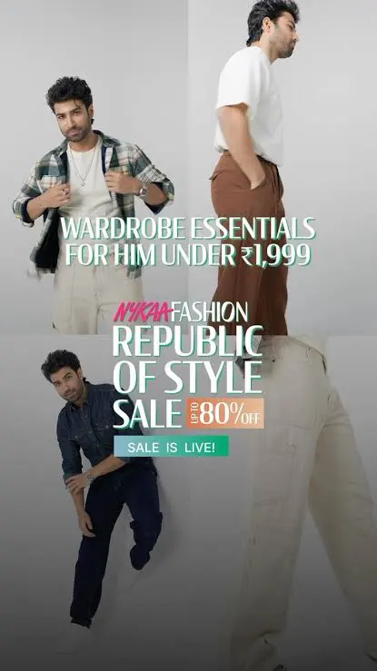

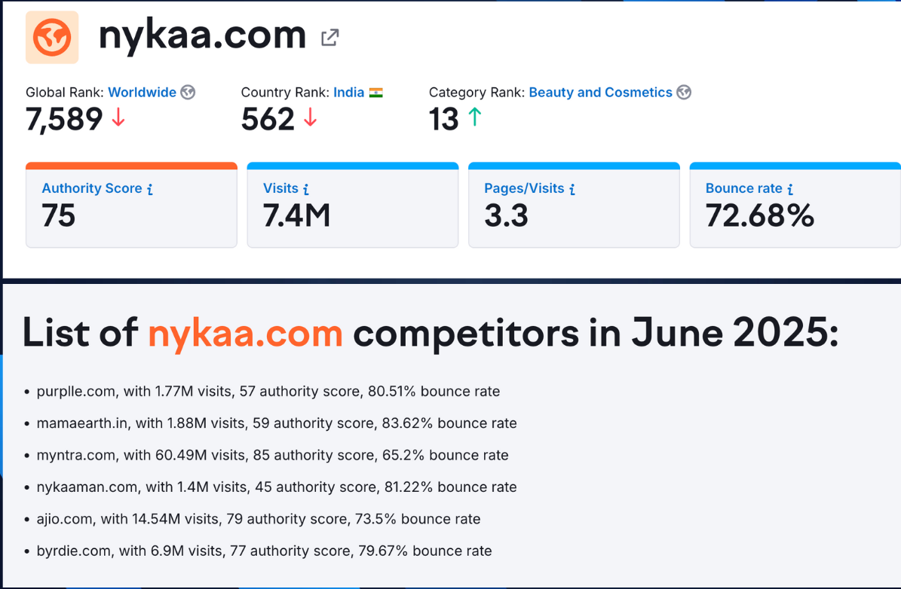

Slide 8
FINANCIAL STATEMENTS
For Fiscal Year 2025
Oct. 1, 2021 – Sep. 30, 2025
-2.3%
-10%
-10%
+2.3%
-3.9%
+12%
-5.2%
+5.2%
+7.1%
-8.9%
-8.9%
+3.9%
+8.9%
+8.9%
+5.3%
+6.0%
-10%
-10%
-7.1%
Prepared for Nykaa fashion
+10%
-8.3%
-8.9%
+5.2%
+7.1%
-8.3%
+7.1%
+5.3%
-4.3%
-5.3%
-7.1%
-11%
+11%
-11%
+12%
-3.9%
+3.9%
-3.9%
+8.3%
-3.9%
-5.3%
+5.2%
+5.3%
-7.1%
+6.0%
-11%
+5.3%
-5.2%

Slide 9
REVENUE GROWTH
Assets
Profit before tax
&
$1200cr+
Revenue from sale
$800cr+
Profit before tax
A stacked column showing total revenue over the course of 4 years, assets have been valued at a total of 1200cr
A stacked column showing total profit before tax over the course of 4 years, liabilities have been valued at a total of 800cr

Slide 10
Report generated on 2025
Balance Sheet Data Visualization
Net Income
Stock Buybacks
Dividends
2017
2018
2019
2020
2021
2022
2023
2024
2025

Slide 11
20B
15B
25B
3800cr (12%)
Gross Margin (GM)
10B
30B
1850cr (37%)
Operating Expense (OPEX)
1374cr (16%)
5B
40B
Earnings Before Interest & Taxes (EBIT)
Financial Indicators
119cr (14%)
Profit Before Tax (PBT)
0B
45B
ROA
Return on Asset
18.7%
ROE
Return on Equity
19.2%
ROIC
Return on Invested Capital
12.8%

Slide 12
Customer Review
Avg
Avg
Avg
Good
Good
Good
Bad
Better
Bad
Better
Bad
Better
Worse
Best
Worse
Best
Worse
Best
2025
2025
2025
Quality
Customer service
Delivery
Authentic and sealed products
No toxic chemicals involved
No proper customer redressal system
Good customer service .
Delivery delays (especially in Tier-2/3 cities).
Prepaid orders marked
‘delivered’ but never received

Slide 13
STRATEGIC RECOMMENDATIONS
Improve Nykaa Prive membership features ie. Prive Member , Gold & Platinum.
Improve Customer Service and Return Logistics (To improve refund and enhance speed
Tier-2 & Tier-3 Expansion, Use “lite” delivery formats or franchise- owned stores
Optimize Omnichannel Experience ie. “buy online, pick up in store (BOPIS)”and “store return for online orders”
Nykaa could focus on Men cosmetics , Baby care products , Sustainability etc
Hyper-Personalization with AI
Leverage customer data to offer curated fashion feeds, size recommendations, and style suggestions.
Implement AI-driven styling assistants to boost conversion rates.
Data-Driven Inventory Management
Use predictive analytics to optimize stock levels and reduce dead inventory.
Tier 2 & 3 City Penetration
Expand marketing and logistics to reach aspirational shoppers in smaller cities.
Offer regional language support and localized campaigns.
Expand Private Label Portfolio
Focus on developing in-house fashion brands across categories like ethnic wear, activewear, and accessories.
Private labels offer higher margins and brand control, and Nykaa already sees strong traction in this area.
Strengthen Omnichannel Experience
Integrate offline stores with the online platform for seamless browsing, trial, and purchase.
Use tech like AR/VR for virtual try-ons and in-store personalization.

Slide 14
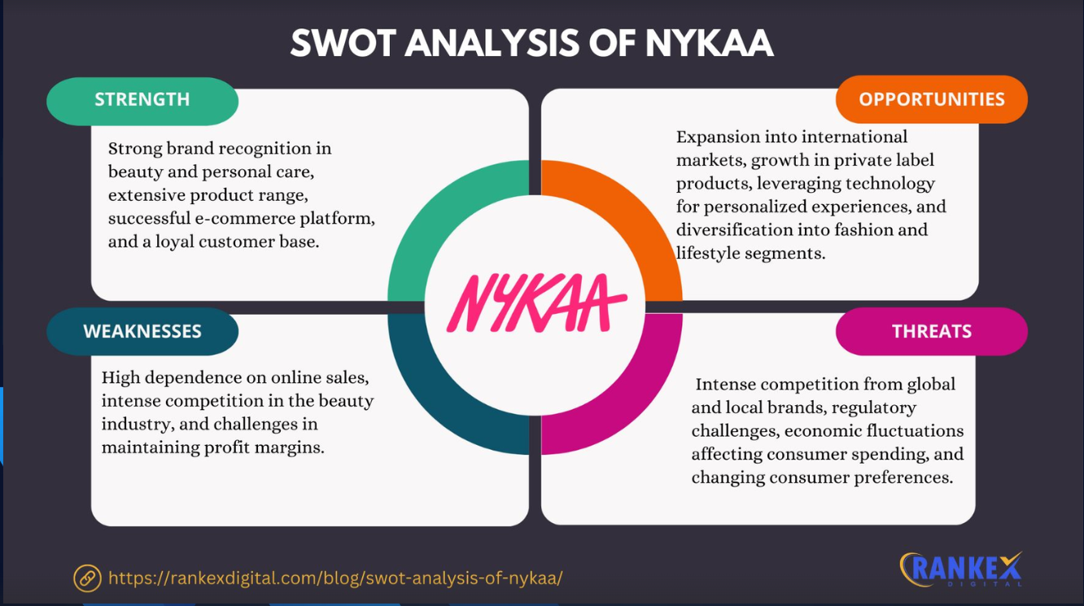

Slide 15
WEBSITES USED FOR ANALYSIS
https://www.moneycontrol.com/india/stockpricequote/miscellaneous/fsne-commerceventuresnykaa
https://rankexdigital.com/swot-analysis-of-nykaa/
https://www.reddit.com/r/IndianMakeupAddicts/comments
https://chatgpt.com/c/6881dd08-5d40-800a-bc8f-2910ef4f0e13
https://www.nykaa.com/
https://www.mouthshut.com/
https://www.trustpilot.com/review/nykaa.com

Slide 16

THANK YOU
ANY QUESTIONS?

